Slide 1
Fundamentals of Data Visualization
Ashwin Malshe, PhD

Slide 2

“Sometimes [data] science is more art than science, Morty. A lot of people don’t get that.”
–Rick Sanchez (Rick and Morty)

Slide 3
Need for visualization
To a large extent data visualization is necessitated by two aspects of human mind
Humans are good at pattern recognition in images
Humans have a limited capacity to process information

Slide 4

https://www.flickr.com/photos/prwphotos/4779121878/

Slide 5
What do you see in the clouds?
1) Elephant
2) Monkey
3) Nothing

Slide 6
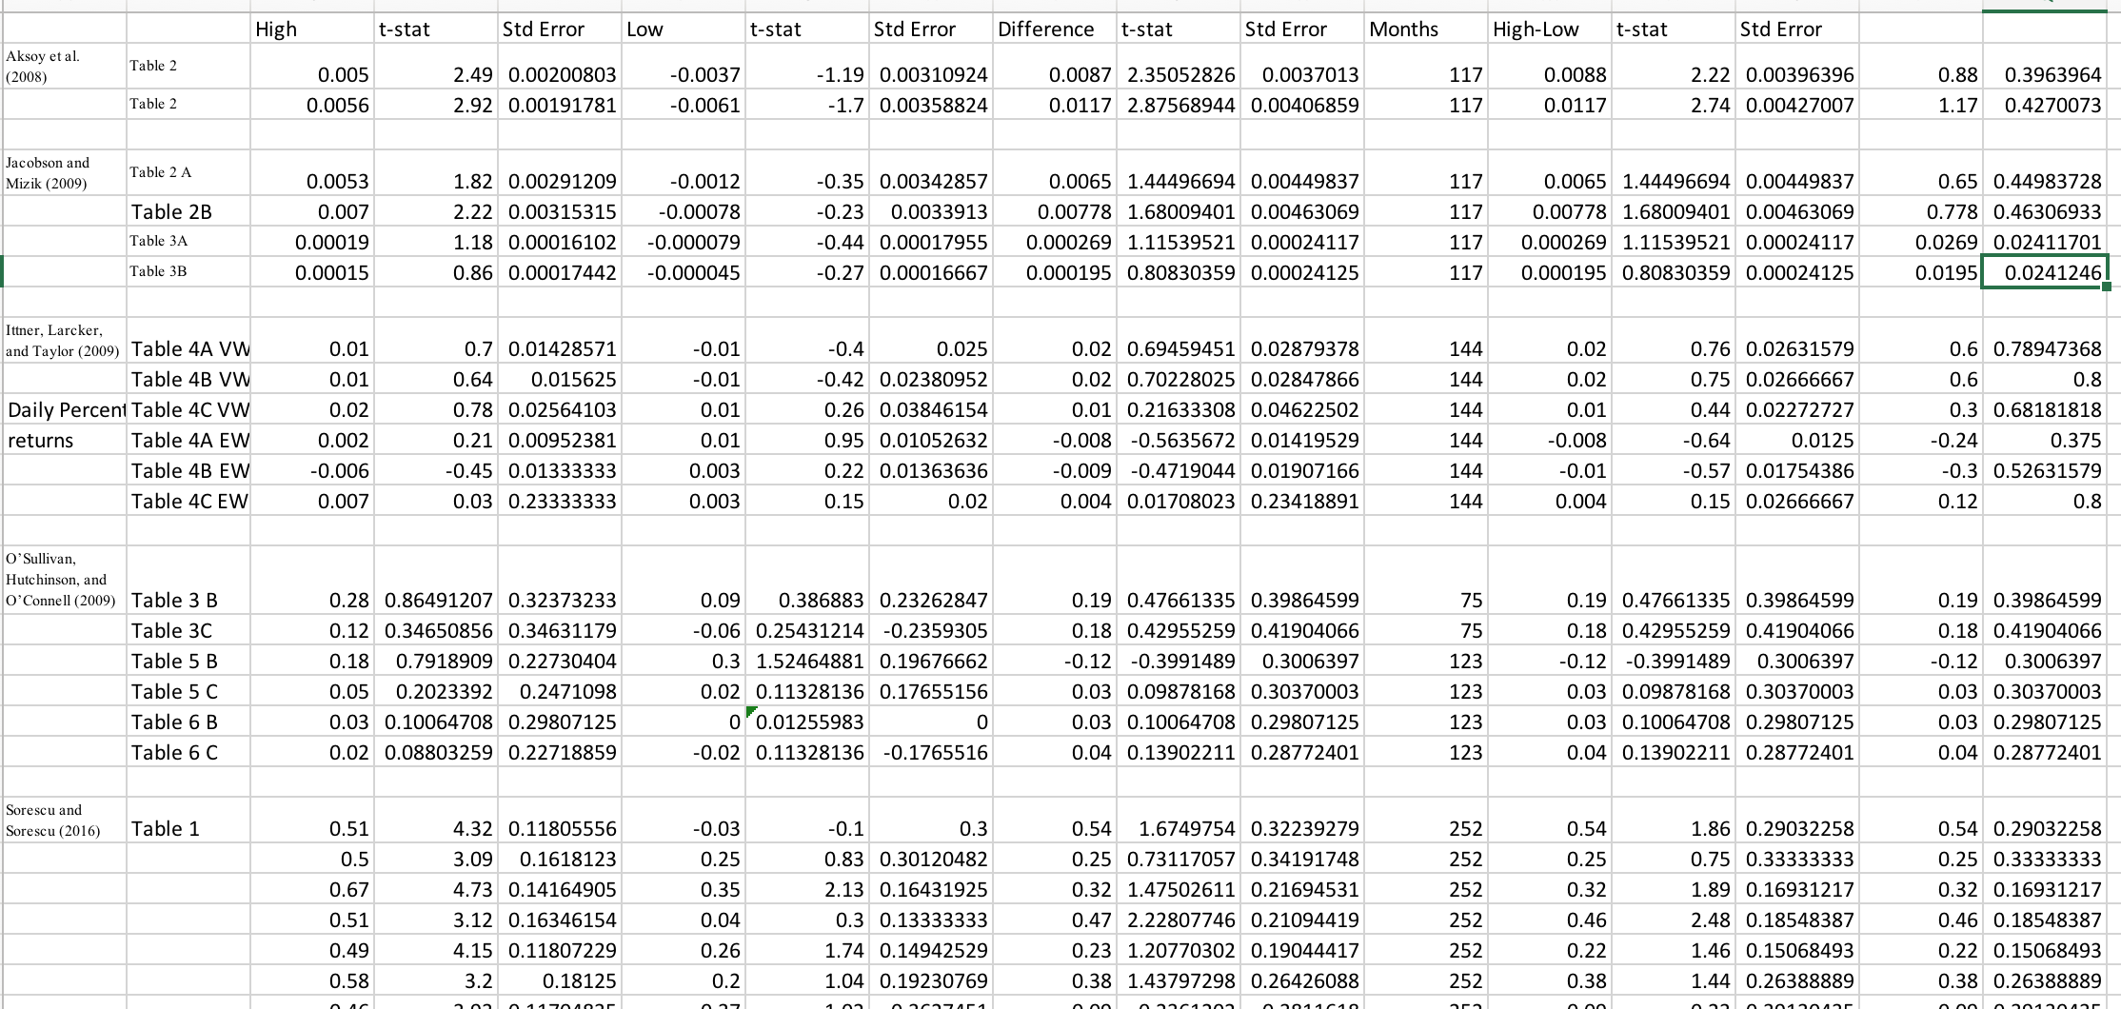
Now do you see any pattern?

Slide 8
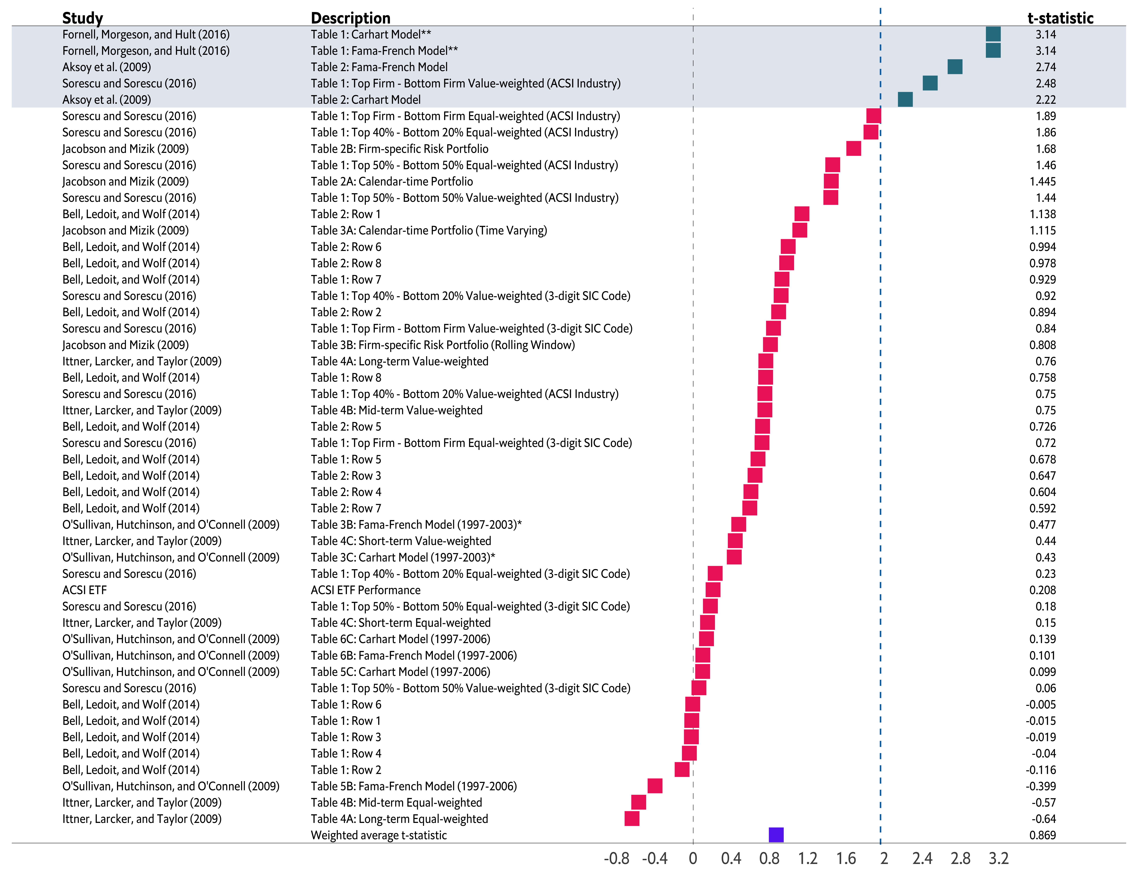

Slide 9

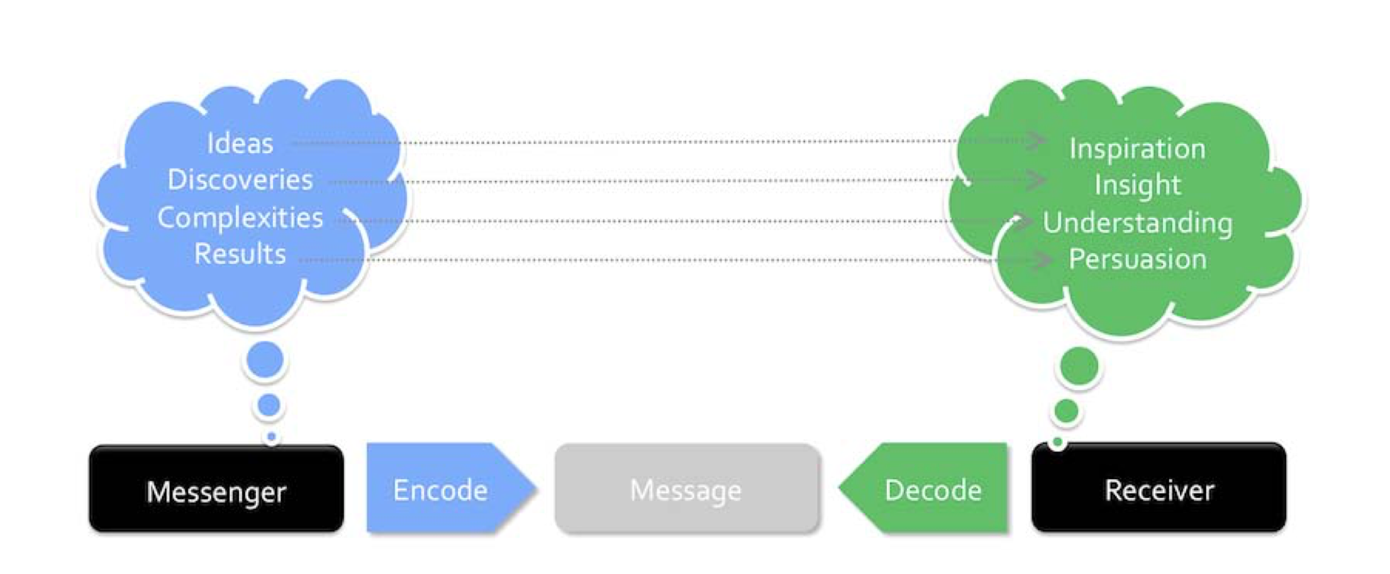

Slide 10
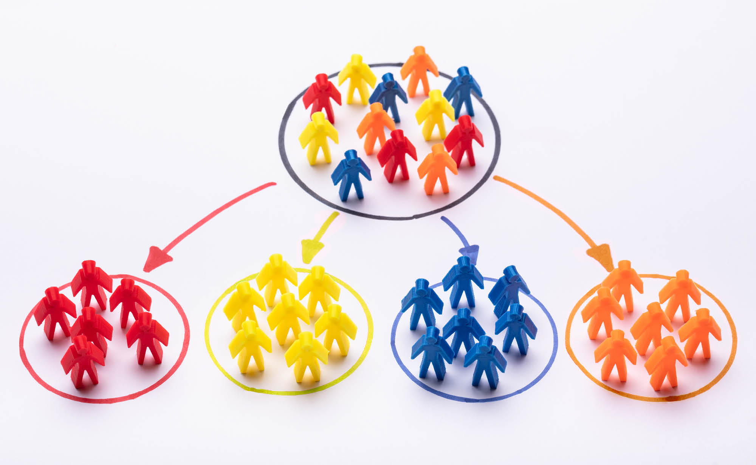
Customer segmentation
https://www.itagroup.com/insights/keys-successful-customer-segmentation-cmb-insights

Slide 11
Do you think this information will help the marketing manager in their campaign planning?
1) Yes, this is critical information
2) It’s unlikely to help the marketer

Slide 12
“Visualization is the representation and presentation of data that exploits our visual perception abilities in order to amplify cognition.”
–Andy Kirk

Slide 13
The representation of data is the way you decide to depict data through a choice of physical forms.
The presentation of data goes beyond the representation of data and concerns how you integrate your data representation into the overall communicated work, including the choice of colors, annotations, and interactive features.
Exploiting our visual perception abilities relates to the scientific understanding of how our eyes and brains process information most effectively
Amplify cognition is about maximizing how efficiently and effectively we are able to process the information into thoughts, insights, and knowledge.

Slide 14
TED Talk on Visualization

Slide 15
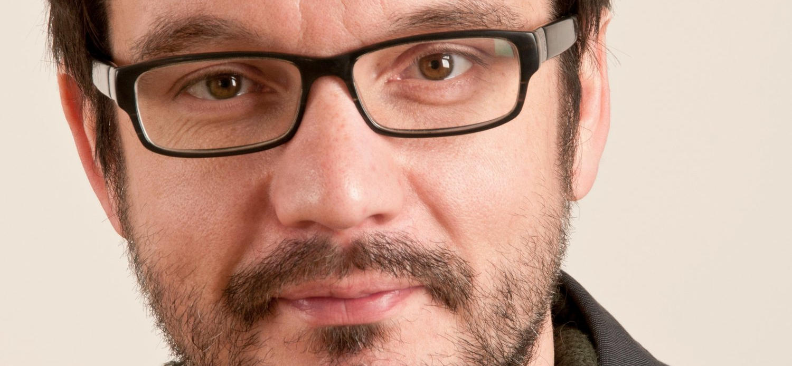
David McCandless
https://informationisbeautiful.net

Slide 16
https://www.ted.com/talks/david_mccandless_the_beauty_of_data_visualization

